Slide 1
INVESTMENT CASE STUDY SUBMISSION
Group Name:
Durga Sasidhar Attaluri

Slide 2
Abstract
The objective is to identify the best sectors, countries, and a suitable investment type for making investments for Spark Funds considering the investments in range of 5 to 15 million USD in English speaking countries.
The data obtained is from crunchbase.com and the strategy is to identify where the most investors are investing. 77.02% of data retained after handling the missing data .As per the analysis on that data we identified –
Venture type as the preferred type of investment.
US, Great Britain, India as the preferred countries to invest.
Others, Cleantech/Semiconductors, Social Finance Analytics Advertising, News Search and Messaging, Entertainment as preferred sectors to invest in those countries.

Slide 3
Problem solving methodology

Slide 4
Analysis – Investment Type
For choosing the best investment the metrics with average funding amount between 5 to 15 million USD and the funding type with highest number of investments are considered.
As part of handling the missing data additional columns (funding_round_code, founded_at, homepage_url, state_code, region) and null rows are removed.
77.02 % of data retained after treating the missing data
Startup funding types Seed, Angel, Venture and Private Equity are considered for the investment range between 5 to 15 million USD
The average funding amount and number of investments on the funding type are mentioned in the table
Funding Type | Avg Funding Amount (USD) | No Of Investments
Venture | 11724222.690 | 47809
Seed | 747793.682 | 21095
Angel | 971573.891 | 1320
Private Equity | 73938486.275 | 1820
Based on the assumptions mentioned above Venture type is the most suitable funding type for Spark Funds to invest in.

Slide 5
Analysis - Countries
Of the Venture investment type, the countries with highest investment amount and English as an official language are considered the best for investment for Spark Funds
Here the data is not filtered in the range of 5 to 15 million and all the investment amounts are considered to find the best countries for investment.
The table shows the investment amounts of top 9 countries.
Only USA, GBR, IND, CAN are English speaking countries in the above table
Though China has second highest investments it is not considered as best country to invest in as English is not official language
USA, GBR and IND are considered as the top 3 best countries for Spark Funds to invest in.
Country Code | Total Invest Amount (USD)
USA | 420068029342
CHN | 39338918773
GBR | 20072813004
IND | 14261508718
CAN | 9482217668
FRA | 7226851352
ISR | 6854350477
DEU | 6306921981
JPN | 3167647127

Slide 6
Analysis - Sectors
Sectors | USA | GBR | IND
Others | 2923 | 143 | 109
Cleantech / Semiconductors | 2297 | 127 | 20
Social, Finance, Analytics, Advertising | 1912 | 98 | 32
News, Search and Messaging | 1563 | 73 | 52
Automotive & Sports | 167 | 16 | 13
Health | 908 | 24 | 19
Manufacturing | 799 | 42 | 21
Entertainment | 580 | 54 | 33
All the primary categories of investments are mapped to 8 sectors.
Investments of the Venture type and in the range of 5 to 15 million USD are considered.
Only top three English speaking countries with highest investments are considered.
Sectors with the highest number of investments are considered as the best countries to invest in.
The table shows the number of investments for each sector in each country.
The best sectors are highlighted in Green and the observations are as follows
Best sectors to invest in USA – Others, Cleantech/Semiconductors, Social Finance Analytics & Advertising
Best sectors to invest in GBR - Others, Cleantech/Semiconductors, Social Finance Analytics & Advertising
Best sectors to invest in IND – Others, News Search and Messaging, India

Slide 7
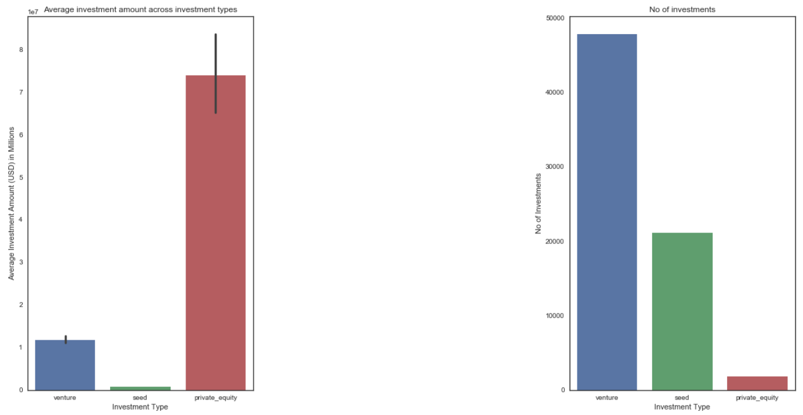
Results – Investment Analysis
Left plot – Bar plot of Avg amount of investments against Investment type
Right plot – Count plot of No of investments against Investment type
The two plots show Venture type has average investments between 5 to 15 million

Slide 8
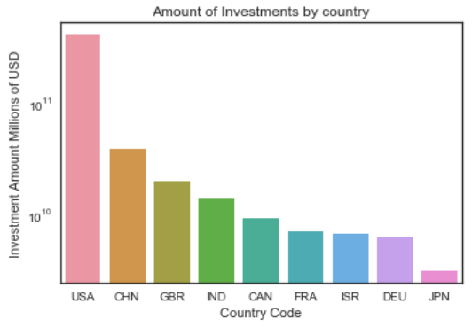
Results – Country Analysis
The bar plot shows the amount of investments by country code of venture investment type in decreasing order.
USA, CHN, GBR, IND, CAN, FRA, ISR, DEU, JPN are top 9 countries to investment.
USA, GBR, IND are top three English speaking countries to invest
Y axis - Values are in log scale

Slide 9
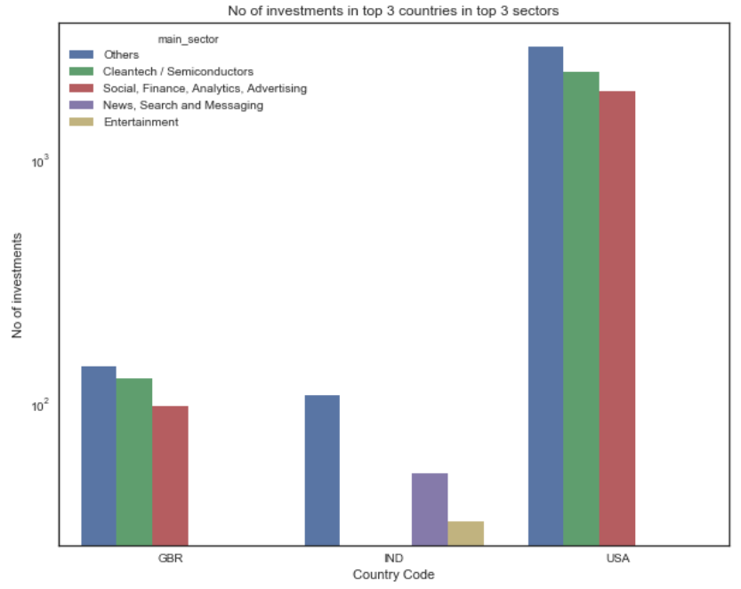
Results – Sector Analysis
The bar plot shows the top 3 sectors to invest for Venture type in top 3 countries in the range of 5 to 15 million USD
Others, Cleantech / Semiconductors, Social Finance Analytics Advertising best sectors to invest in USA and GBR
Others, News Search and Messaging, Entertainment best sectors to invest in IND
Y axis - Values are in log scale

Slide 10
Conclusions
Based on the analysis performed here are the conclusions for the best investment type, best countries and sectors to invest in
Best Investment Type – Venture
Best Countries to Invest – USA, Great Britain, India which are English speaking
Best Sectors to Invest – Others, Cleantech / Semiconductors, Social Finance Analytics Advertising, News Search and Messaging, Entertainment are the best sectors to invest

